Slide 1
QUANTITATIVE RESEARCH PROJECT
S&P 500 Factor Investing
A Multi-Strategy Research Project
Quality, value, momentum, and trend factors on a frozen S&P 500 universe — from assignment baseline to risk-managed and cost-tested variants.
Common evaluation window: 2016-05-31 → 2026-05-31 (121 months)
A reproducible research artifact for studying factor-construction and backtest methodology — not an investment recommendation or a production trading system.
Notes:
Welcome. This deck presents a reproducible S&P 500 factor-investing research project built around four factors — quality (ROE), value (inverse P/E), 12-month momentum, and a moving-average trend factor. The framing point to make up front: this is an academic research artifact that emphasises transparent, one-change-at-a-time methodology, not a live-trading product. Every strategy is evaluated over a common window, 2016-05-31 to 2026-05-31, so cross-strategy comparisons are apples-to-apples.

Slide 2
MOTIVATION
Research Question
• Can a transparent, long-only multi-factor S&P 500 strategy outperform two honest benchmarks?
– (1) random stock selection from the same eligible universe (Monte Carlo null), and
– (2) the cap-weighted S&P 500 index (^GSPC), on a risk-adjusted basis.
• The discipline: change exactly one design dimension at a time so every performance change has an unambiguous cause.
• Success is judged on Sharpe, drawdown, and statistical separation from random — after realistic research constraints.
Framing
Eight strategy variants share one four-factor backbone. The project is structured to surface honest answers, not optimistic ones: every number is reproducible from frozen raw CSVs, and every deviation from academic best practice is disclosed.
Scope
Academic research artifact — transparent methodology over a single opaque “final” strategy. Not a production trading system.
Common evaluation window: 2016-05-31 → 2026-05-31 (121 months)
Notes:
The research question is deliberately modest and testable. We are not asking 'is this a good investment' — we are asking whether a simple, transparent factor ranking can beat two honest benchmarks: a random portfolio drawn from the same eligibility rules, and the index itself. Framing it against random selection is important because it guards against fooling ourselves with a number that merely reflects a rising market. The one-change-at-a-time discipline is what makes the project scientifically readable.

Slide 3
THE REVIEWED PAPER
Research Foundation — Han, Zhou & Zhu (2016)
“A Trend Factor: Any Economic Gains from Using Information over Investment Horizons?” Journal of Financial Economics 122 (2016), 352–375.
• Proposes a trend factor combining short-, intermediate-, and long-horizon price information in one signal.
• Uses normalized moving averages across 11 horizons: 3, 5, 10, 20, 50, 100, 200, 400, 600, 800, 1000 trading days.
• Each month: cross-sectional regression of stock returns on the normalized MA signals; expected returns from the fitted model.
• Forms a long-short factor: long highest expected-return quintile, short lowest (Q5 − Q1).
• In US stocks 1930–2014, the trend factor outperforms standalone short-term reversal, momentum, and long-term reversal — with better crisis behavior than momentum.
Adaptation note
This project does NOT fully replicate the paper's long-short Q5−Q1 factor. It is mostly long-only and S&P 500-focused. Improved 6 is the closest paper-faithful variant (HZZ cross-sectional trend). Base and Improved 1–5/7/8 use an assignment-driven index-regression trend, not the paper's exact construction.
The four-factor backbone adds quality (Asness et al.), value (Fama-French), and momentum (Jegadeesh-Titman).
Notes:
This slide summarises the paper the project is built on, for anyone who has not read it. Han, Zhou and Zhu propose a single trend factor that blends price information across eleven horizons, from three days to a thousand, using normalized moving averages. Each month they run a cross-sectional regression of returns on those signals, predict expected returns, and build a long-short portfolio that is long the top expected-return quintile and short the bottom. On US data from 1930 to 2014 it beats standalone reversal and momentum and behaved better in the financial crisis. The crucial honesty point on the right: we do not fully replicate their long-short factor. Our work is mostly long-only on the S&P 500. Improved 6 is the closest paper-faithful variant; the others use an assignment-driven index-regression trend instead.

Slide 4
INPUTS
Data & Universe
Raw file (frozen CSV) | Source | Rows | Span
Daily prices (OHLCV + adj.) | Tiingo | 2,292,658 | 2006–2026
Daily fundamentals (P/E, P/B, PEG) | Tiingo | 2,295,967 | 2006–2026
Statement fundamentals (point-in-time) | Tiingo | 3,458,978 | 2005–2026
S&P 500 constituents | Wikipedia | 503 | current
Index benchmark ^GSPC | Yahoo | 5,030 | 2006–2026
• 503 current constituents; hard cutoff 2026-05-31.
• Fundamentals joined by date_available — point-in-time, no statement look-ahead.
• Daily → monthly factor panel; ~200 MB via Git LFS.
SURVIVORSHIP BIAS: The universe is current constituents only. Delisted/removed names (Lehman, Bear Stearns, GE pre-2018, …) are absent, and recent additions carry full backfilled histories — survivorship bias inflates Sharpe and depresses drawdown.
Sources: data/raw/DATA_DESCRIPTION.md, docs/DATA_DICTIONARY.md, results/data_audit.csv
Notes:
Five frozen raw files feed the pipeline. The point-in-time treatment of statement fundamentals via date_available is a genuine strength — it prevents using earnings before they were public. But flag the elephant in the room now, not in the backup: the universe is today's S&P 500. Companies that failed or were removed are missing, and recent additions like Palantir or Coinbase appear with full price histories the strategy could 'pick' before they actually joined the index. Both effects bias results optimistically. The planned fix is a WRDS/CRSP point-in-time membership panel.

Slide 5
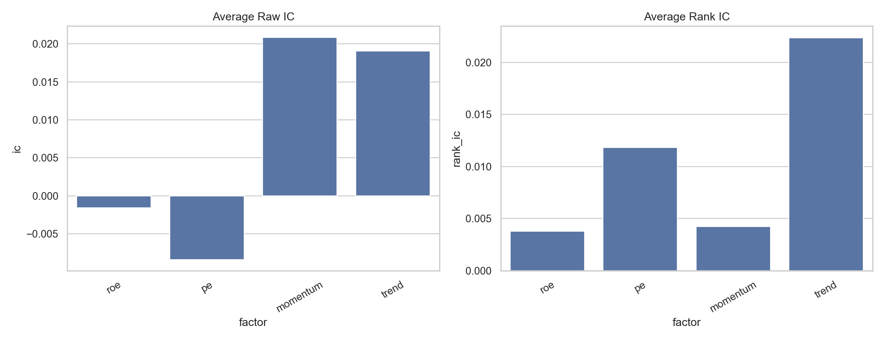
SIGNALS
Factor Construction
Factor | Family | Definition
ROE | Quality | Point-in-time return on equity
− P/E | Value | Inverted P/E — cheaper scores higher
Momentum | Momentum | 12-month price return (t-12 → t)
Trend | Trend | Moving-average trend (HZZ 2016)
• Each factor lagged one month (signal at t → trade at t+1).
• Winsorized at 1st/99th pct within each month, then cross-sectionally z-scored.
• Composite = equal-weighted mean of the four z-scores.
• Three trend implementations — the key methodological fork:
– base: full-sample index regression — has look-ahead bias.
– improved 1–5, 7: expanding-window index regression — no look-ahead.
– improved 6: HZZ stock-level cross-sectional regression — paper-faithful.
Information coefficients by factor — trend carries the strongest, most consistent rank IC.
Trend is the dominant single factor; quality and value are weak in isolation (Section 9.5).
Notes:
Four factors, one composite. The mechanics matter for credibility: everything is lagged a month to avoid using same-month information, winsorized to tame outliers, and z-scored so the four signals are comparable before averaging. The most important nuance is the trend factor, which has three implementations. The base uses a full-sample regression that peeks at the future — we keep it only because the assignment prescribes it. Improved 1 onward uses an expanding window with no look-ahead, and Improved 6 implements the actual Han-Zhou-Zhu cross-sectional methodology. The IC chart shows trend is the workhorse; quality and value add diversification more than standalone return.

Slide 6
END-TO-END DESIGN
Strategy Specification
Component | Implementation
Universe | 503 current S&P 500 securities, frozen through 2026-05-31
Frequency | Monthly signal & rebalance; daily Backtrader execution for stop/take
Factors | ROE, inverse P/E, 12-month momentum, trend
Signal processing | 1-month lag, 1st/99th winsorization, cross-sectional z-score
Composite score | Weighted mean of available factor z-scores
Base selection | Top 10 by composite score
Improved 4 | Top 10, expanding trend, 5% stop / 30% take
Improved 8 | Top 20, 5%-of-equity per position, 5% stop / 30% take
Position sizing | $100K fixed (base–Imp 7); percent-of-equity (Imp 8)
Execution | Market entries/rebalances; native stop + limit (OCO) exits
Costs | Zero in main runs; vector cost scenarios in Improved 7
Evaluation window | 2016-05-31 → 2026-05-31 (121 months)
A single auditable specification. Source: src/project_core.py StrategySpec; README §5–§8.
Notes:
This is the project's strategy distilled to one auditable table — the kind of specification a reviewer or an investor's analyst would want. It captures the universe, the monthly cadence with daily execution for the stop/take variants, the four factors, the signal processing pipeline of lag, winsorization and z-scoring, the composite, the selection rule, the two winners' exact configurations, the sizing rules, the execution model, the cost treatment, and the common evaluation window. The point to make: nothing here is hidden or hand-wavy — every line maps to a constant or a StrategySpec field in the source code.

Slide 7
METHOD
The Strategy Ladder — Eight Variants
Variant | One change from foundation | Verdict | Message
Base | Assignment full-sample trend | Baseline* | Strong but look-ahead-biased
Improved 1 | Expanding no-lookahead trend | Kept | Honest baseline; removes look-ahead
Improved 2 | Add 10% stop / 20% take | Kept | Risk-management layer
Improved 3 | Dynamic rank-IC weights | Rejected | Adaptive weighting did not help
Improved 4 | Walk-forward stop/take 5% / 30% | Winner | Best risk-managed variant
Improved 5 | 10-mo SMA regime filter | Rejected | Strips useful exposure
Improved 6 | HZZ cross-sectional trend | Kept | Paper-faithful; lower per-trade alpha
Improved 7 | Time-varying costs (4 & 6) | Study | Cost sensitivity, NOT a strategy
Improved 8 | Top-20 + equal-weight 5% | Winner | Wealth-maximizer; lower Sharpe, higher DD
One change at a time. Winners: Improved 4 (risk-managed) & Improved 8 (wealth). *Base look-ahead-biased.
Notes:
This is the heart of the project: a ladder where each rung changes one thing. Base is the assignment-faithful starting point but it is look-ahead-biased — never present it as a winner. Improved 1 is the honest baseline. Improved 2 adds risk exits. Improved 3 tried dynamic factor weights and failed — we keep failures visible. Improved 4 is the best risk-managed variant after a walk-forward search over stop/take levels. Improved 5's regime filter hurt and was rejected. Improved 6 implements the paper's true methodology. Improved 7 is a cost-sensitivity study of the two finalists — emphasise it is NOT a separate portfolio. Improved 8 changes the sizing rule to chase absolute wealth. The two highlighted rows are the two defensible winners on different criteria.

Slide 8
IMPLEMENTATION
How the Strategy Is Coded
• src/project_core.py — factors, StrategySpec, scoring, vector sim, Backtrader engines, validation, figures.
• src/run_project.py — full pipeline (base → Improved 3).
• run_improved_4_stop_take_sensitivity.py — stop/take grid.
• run_improved_6_hzz_trend.py — HZZ cross-sectional trend.
• run_improved_7_costs.py — cost sensitivity.
• run_improved_8_top_n_sizing.py — equal-weight top-20.
Backtrader stop / take (OCO)
# protective exits, submitted after the entry fills
stop = self.sell(data=d, size=int(sz),
exectype=bt.Order.Stop,
price=entry * (1 - stop_loss))
limit = self.sell(data=d, size=int(sz),
exectype=bt.Order.Limit,
price=entry * (1 + take_profit),
oco=stop) # one-cancels-other
Strategy configuration
@dataclass(frozen=True)
class StrategySpec:
name: str
weights: dict[str, float]
top_n: int = 10
stop_loss: float | None = None
take_profit: float | None = None
trend_col: str = "trend_z"
sizing_method: str = "fixed_cash"
sizing_target_pct: float = 0.10
Improved 8 spec (one config object)
core.StrategySpec(
name=core.IMPROVED_8_STRATEGY_NAME,
weights={"roe":1,"pe":1,"momentum":1,"trend":1},
top_n=20, trend_col="trend_expanding_z",
stop_loss=0.05, take_profit=0.30,
sizing_method="percent_of_equity",
sizing_target_pct=0.05)
Explicit, declarative specs — not conceptual. Every variant is one StrategySpec plus a runner.
Notes:
This slide shows the project is real code, not just a concept. The left column is the file map: a single core module holds the factor construction, the strategy specification, scoring, the vector simulator, the Backtrader engines, validation and figures; thin runner scripts drive each variant. The three snippets show the pattern. First, every strategy is a frozen dataclass — weights, top-N, stop, take, trend column, sizing rule. Second, the Backtrader stop and take are native broker orders, OCO-linked so one cancels the other, and submitted only after the entry fills. Third, Improved 8 is literally one config object with top-N twenty and percent-of-equity sizing. That declarative design is what makes the one-change-at-a-time discipline enforceable.

Slide 9
RESULTS — EVAL WINDOW
Headline Results
Strategy | BT Sharpe | BT Max DD | BT Final | Vec Final | MC p
Base* | 1.36 | −6.8% | $5.78M | $2.03M | 0.013
Improved 1 | 1.22 | −17.2% | $3.77M | $3.51M | 0.019
Improved 2 | 1.26 | −13.5% | $2.89M | $2.72M | 0.068
Improved 3 | 1.21 | −15.5% | $2.68M | $2.64M | 0.157
Improved 4 | 1.40 | −7.7% | $2.82M | $2.75M | 0.088
Improved 5 | 1.06 | −10.6% | $2.11M | $2.15M | 0.099
Improved 6 | 1.02 | −11.2% | $3.16M | $2.04M | 0.290
Improved 8 | 1.11 | −11.9% | $3.09M | $3.63M | 0.306
Risk-managed
Improved 4 — best Backtrader Sharpe (1.40) and lowest drawdown (−7.7%) among honest variants.
Wealth-oriented
Improved 8 — highest vector final equity ($3.63M); lower Sharpe because capital is diversified across ~17 names.
Why two final-equity columns?
Vector restates wealth from $1M at eval start; Backtrader tracks absolute value across all years. Sharpes use only the eval window in both — directly comparable.
*Base look-ahead-biased (greyed). Bold = best-in-column among honest variants. Source: README §9.1.
Notes:
This is the canonical results table from README Section 9.1, over the common evaluation window. Read it carefully. Base posts the biggest Backtrader final value but it is look-ahead-biased — greyed out, not a winner. Among the honest variants, two stories stand out. Improved 4 has the best risk-adjusted profile: Sharpe 1.40 and the shallowest drawdown at minus 7.7 percent. Improved 8 builds the most absolute wealth on the vector engine at 3.63 million, but its Sharpe is lower and drawdown deeper because it spreads capital across about 17 names. The two final-equity columns differ by construction: the vector engine restates from one million at the eval start, while Backtrader carries the actual portfolio value, including idle pre-eval cash. Sharpe is computed on the same window in both, so risk-adjusted comparisons are fair. Also note Monte Carlo p-values: only base and improved 1 clear the 0.05 bar, and those p-values are unadjusted for multiple testing.

Slide 10
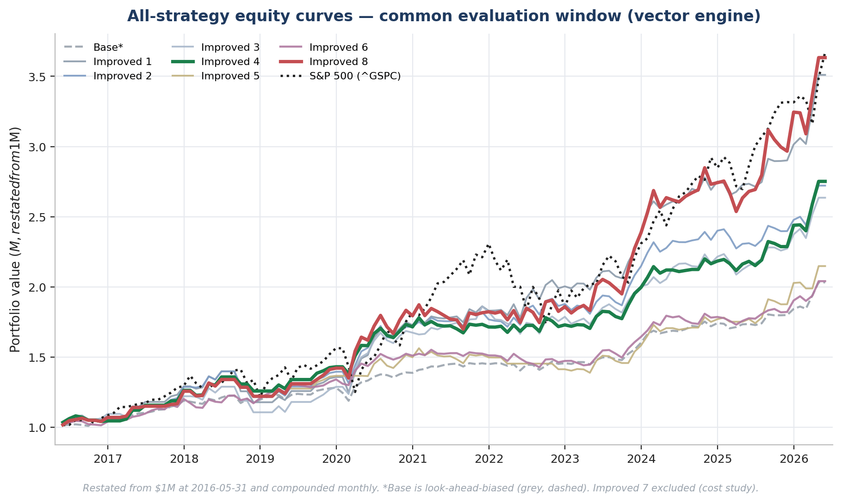
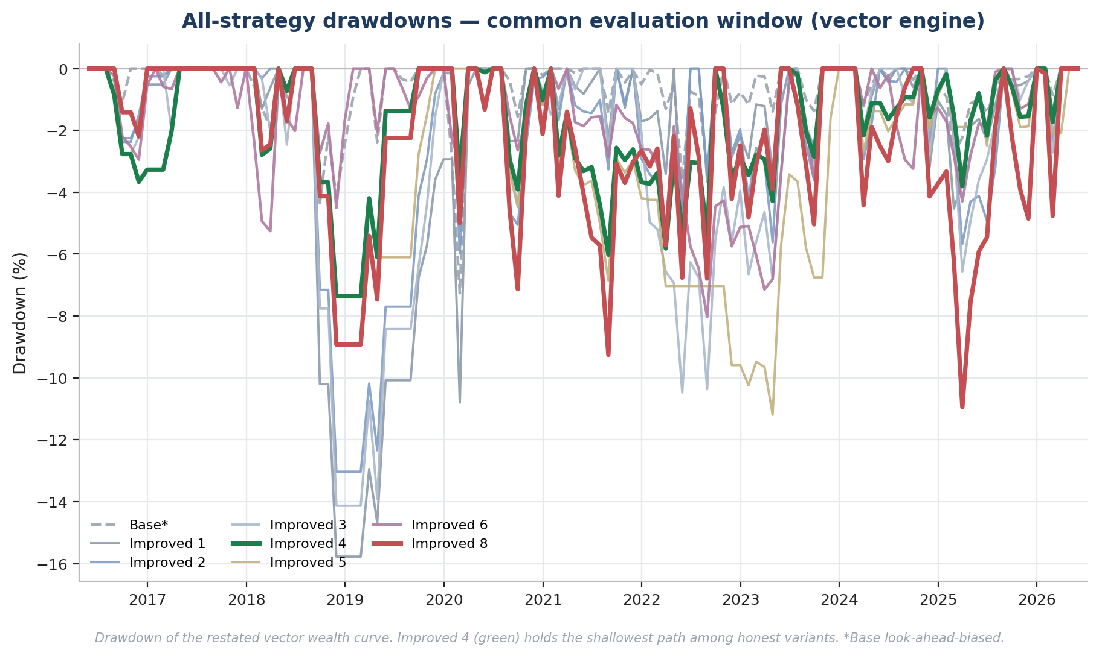
RESULTS — FIGURES
Performance & Risk — All Strategies
Equity curves vs. ^GSPC (vector, restated from $1M at eval start)
Drawdown paths (Improved 4 shallowest among honest variants)
All eight variants shown (Improved 7 excluded — cost study). Active portfolios, negative beta to ^GSPC.
Notes:
These two charts now cover the full ladder — base, Improved 1 through 6, and Improved 8 — so the visuals finally match the strategy story. Both use the vector engine, restating wealth from one million dollars at the evaluation start so the curves are directly comparable. On the left, the honest variants build wealth above the index; Improved 8 in red reaches the highest terminal value. On the right, the drawdown panel is the risk side: Improved 4 in green holds the shallowest drawdown path among honest variants, which is exactly the risk-managed claim. Base is greyed and dashed because it is look-ahead-biased. Improved 7 is excluded because it is a cost-sensitivity study, not a portfolio. The negative beta means these are active rotators, not index trackers.

Slide 11
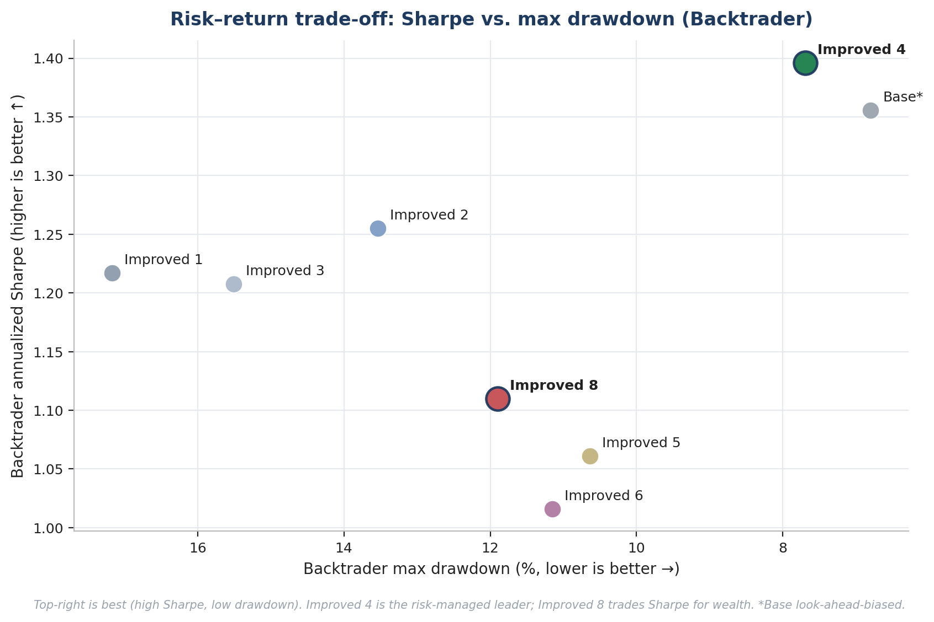
RESULTS — FIGURES
Risk–Return Trade-off
One message
Top-right is best: high Sharpe, shallow drawdown. Improved 4 sits at the efficient corner among honest variants. Improved 8 deliberately moves down-left — it trades risk-adjusted return for absolute wealth.
Caveat
Base appears strong here only because its look-ahead trend suppresses drawdown — not a fair comparison.
Backtrader Sharpe vs. |max drawdown|. Source: results/*/backtrader_*_metrics.csv
Notes:
A scatter makes the risk-return trade-off clearer than a bar chart. The y-axis is Backtrader Sharpe, the x-axis is max drawdown — and I have inverted it so that better, shallower drawdowns are to the right. The ideal corner is top-right. Improved 4, the green point, sits there: best honest Sharpe at 1.40 and the shallowest honest drawdown. Improved 8, the red point, is deliberately lower and to the left — it accepts a lower Sharpe and a deeper drawdown in exchange for higher absolute wealth. Base looks strong in the top-right too, but only because its look-ahead trend artificially suppresses drawdown, so discount it.

Slide 12
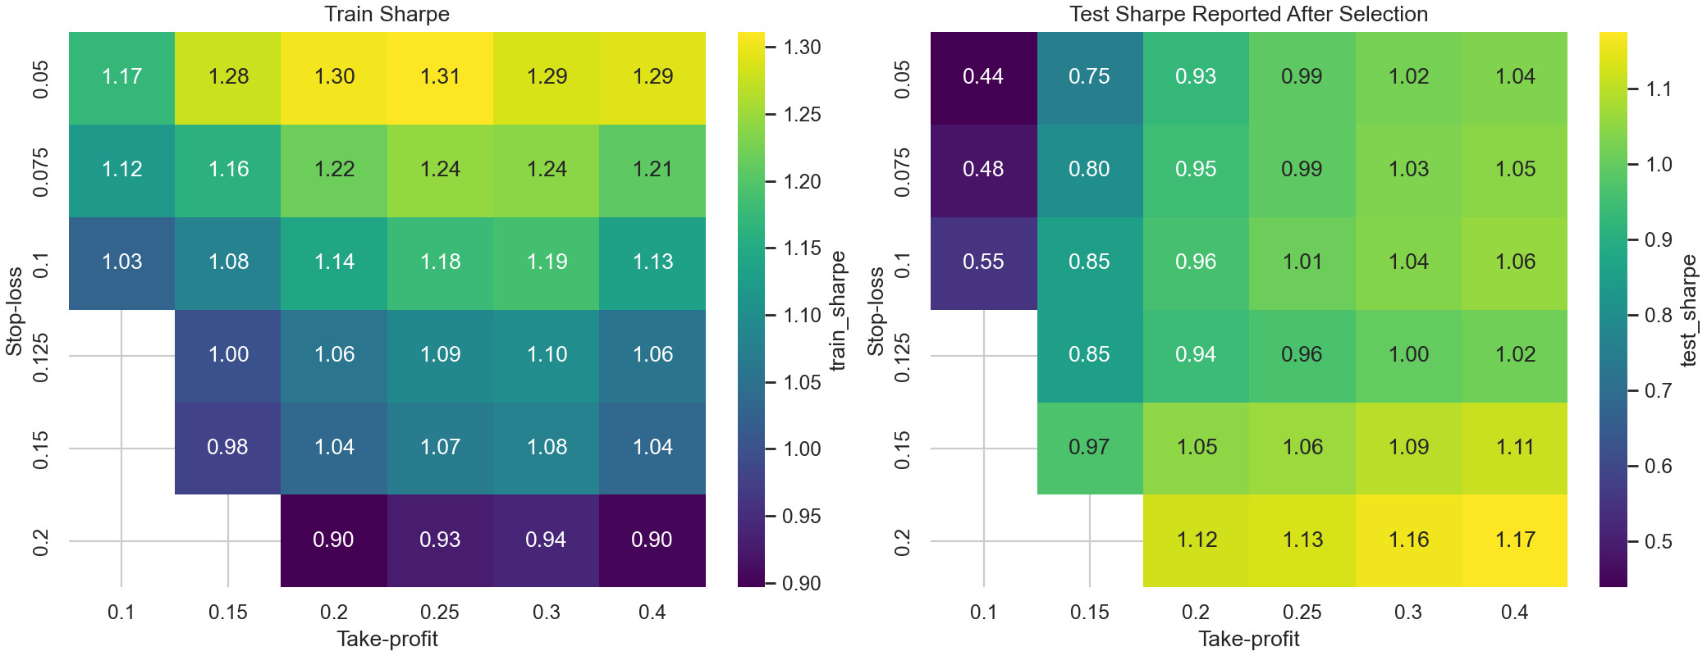
RESULTS — FIGURES
Why Improved 4 — Walk-Forward Stop/Take
• Stop/take chosen by walk-forward on training data through 2020-12, not by full-sample fit.
• Selected pair: 5% stop, 30% take-profit.
• Result: drawdown drops to −7.7% while Sharpe rises to 1.40 — the best risk-managed trade-off in the ladder.
• Honest about tuning: the grid search itself is part of the multiple-testing budget (see Limitations).
Sharpe across the 6×6 stop/take grid (training data ≤ 2020-12)
Source: results/improved_strategy_4/, figures/improved4_stop_take_sensitivity_heatmap.png
Notes:
Improved 4 is the project's best risk-managed variant, and this heatmap explains how its stop and take-profit levels were chosen. Rather than fitting on the whole sample, we ran a walk-forward search over a six-by-six grid using only training data through the end of 2020, then carried the selected five-percent stop and thirty-percent take into the test period. The payoff is a much shallower drawdown with a higher Sharpe. Be candid that the grid search consumes some of our multiple-testing budget — which is exactly why the limitations slide flags data-snooping risk.

Slide 13
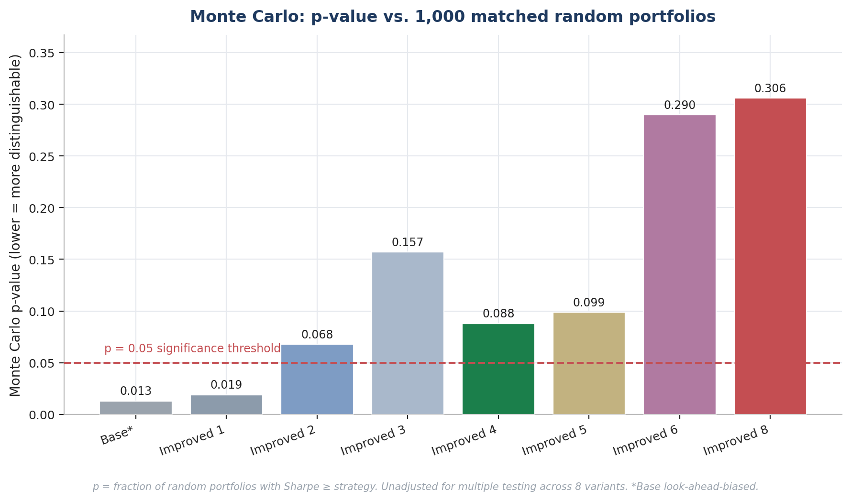
ROBUSTNESS
Validation Battery
• Monte Carlo — 1,000 random portfolios per strategy from the same eligible universe; p = fraction beating the strategy's Sharpe.
• Block bootstrap — 1,000 paths resampling the strategy's own returns in 6-month blocks.
• Walk-forward — train ≤ 2020-12, test 2021+; select on train, report test.
• Benchmark comparison — alpha/beta regression vs ^GSPC.
• Cost sensitivity — time-varying commission + slippage (Improved 7).
• Backtrader — physical broker simulation with native stop/limit (OCO) orders.
Monte Carlo p-value across variants (all 8, base greyed)
HONEST READ: Only base and Improved 1 clear p < 0.05 — and p-values are unadjusted for multiple testing. Walk-forward and benchmark-alpha tables cover base and Improved 1–3 only, NOT Improved 4–8.
Six validation lenses — each interrogates a different failure mode.
Notes:
Robustness is tested six ways, each probing a different weakness. Monte Carlo asks whether a random portfolio under identical rules could match the strategy. Block bootstrap characterises the Sharpe distribution independent of historical ordering. Walk-forward gives an out-of-sample split. The benchmark regression isolates alpha and beta. Cost sensitivity stress-tests execution. And Backtrader is a physical broker simulation. The p-value chart now spans all variants rather than just base. Read it honestly: only base and Improved 1 clear the 0.05 line, and those p-values are not corrected for having tried eight variants — the multiple-testing problem flagged in the limitations. And the walk-forward and benchmark-alpha tables still cover only base through Improved 3; do not imply they validate Improved 4 through 8.

Slide 14
ROBUSTNESS
Validation — Alpha & Walk-Forward
Benchmark alpha vs ^GSPC (eval window)
Walk-forward (train ≤ 2020-12, test 2021+)
Strategy | Ann. Alpha | Alpha t | Alpha p | Beta
Improved 1 | 14.16% | 3.96 | 0.0001 | −0.07
Improved 2 | 11.52% | 3.65 | 0.0003 | −0.07
Improved 3 | 11.16% | 3.11 | 0.0019 | −0.07
Base* | 7.91% | 4.43 | 0.0000 | −0.05
Strategy | Train Shp | Test Shp | Test Cum | Test DD
Improved 2 (selected) | 1.14 | 0.96 | 58.5% | −5.8%
Base* | 1.10 | 1.30 | 46.5% | −3.6%
Improved 1 | 1.03 | 1.34 | 103.1% | −5.2%
Improved 3 | 0.98 | 0.98 | 57.4% | −10.5%
All significant at the 1% level; negative beta = active factor tilt, not index tracking.
Selected on train Sharpe; test reported after selection. A single split is too narrow to crown a winner.
COVERAGE LIMIT: Both tables cover base and Improved 1–3 only — extending alpha and walk-forward to Improved 4–8 is outstanding work.
Sources: results/comparison/strategy_benchmark_comparison.csv, walk_forward_summary.csv
Notes:
Two concrete tables. On the left, every staged variant produces statistically significant alpha versus the index at the one-percent level, with slightly negative beta — confirming these are active, non-tracking portfolios. On the right, the walk-forward split: Improved 2 had the best training Sharpe and would have been selected before 2021, but Improved 1 actually had the strongest post-2020 test Sharpe and return. The lesson is that a single train/test split is too narrow to declare a definitive winner. And again, the honest caveat: both tables stop at Improved 3. We do not yet have alpha or walk-forward coverage for the later variants.

Slide 15
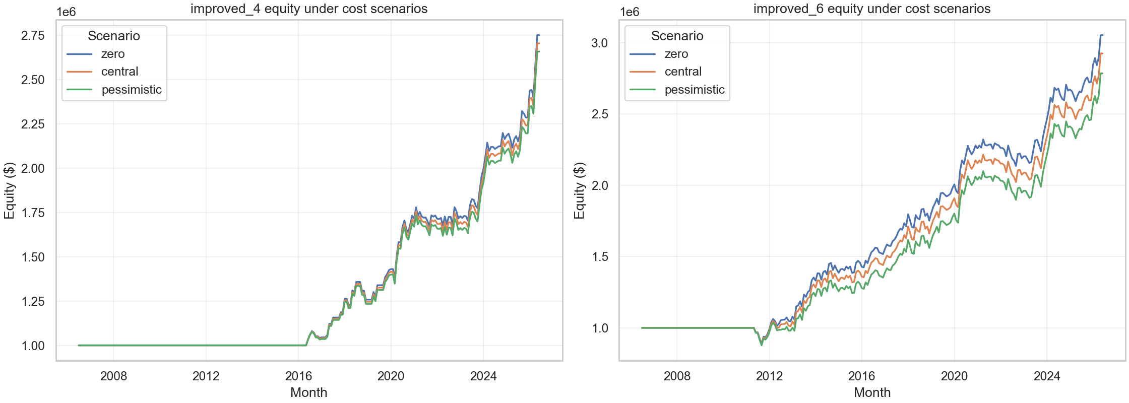
ROBUSTNESS
Transaction-Cost Sensitivity (Improved 7)
Strategy (vector Sharpe) | Zero | Central | Pessimistic
Improved 4 | 1.150 | 1.118 | 1.086
Improved 6 | 1.023 | 0.985 | 0.948
• Time-varying per-year schedule (commission + slippage), 2006–2026, from Frazzini-Israel-Moskowitz (2018) and execution research.
• Three scenarios: zero / central / pessimistic (2× central).
• Both finalists survive pessimistic costs; Improved 4 leads at every level. Sharpe drop is small (~0.03–0.07) — modest monthly turnover, tiny size vs S&P 500 ADV.
SCOPE: This is a vector cost-sensitivity study, not a full dated Backtrader commission/slippage model. Improved 7 is not a standalone strategy.
Equity curves under zero / central / pessimistic costs
Source: results/improved_strategy_7/vector_results_grid.csv
Notes:
Improved 7 stress-tests execution costs on the two finalists, Improved 4 and Improved 6. The schedule is time-varying and grounded in published estimates — higher in the crisis years, lower today. Across zero, central, and a doubled pessimistic scenario, both strategies stay positive and Improved 4 stays ahead at every level. The Sharpe erosion is small because turnover is monthly and position sizes are tiny relative to S&P 500 daily volume. Two honesty flags: this is a vector sensitivity study, not a fully dated Backtrader commission model, and Improved 7 is an analysis layer, not a separate portfolio.

Slide 16
WHAT WE LEARNED
Interpretation
Improved 4 — the Sharpe story
Best risk-managed variant. Highest Backtrader Sharpe (1.40) and shallowest drawdown (−7.7%). Concentrated, walk-forward-tuned risk exits.
Improved 8 — the wealth story
Best wealth-oriented sizing variant. Highest vector final equity ($3.63M) via equal-weight compounding across ~17 names — at the cost of lower Sharpe and deeper drawdown.
• There is no single winner: Improved 4 wins on risk-adjusted return; Improved 8 wins on absolute wealth. The trade-off is exactly what the concentration-vs-diversification literature predicts.
• Trend is the dominant single factor (FMP Sharpe ~0.36–0.39, strongest rank IC); quality and value mainly reduce variance.
• The common-window fix matters: fair Sharpe comparison overturned an earlier spurious “Improved 6 is best” conclusion.
• The defensible claim is relative, not absolute — these strategies beat random and the index on this data, within stated constraints.
Strongest claim: relative, on the available data — not proof of persistent live-trading alpha.
Notes:
Pull the threads together. There is no single best strategy, and that is an honest finding, not a hedge. Improved 4 is the risk-adjusted winner: concentrated, with walk-forward-tuned stops, it delivers the best Sharpe and the shallowest drawdown. Improved 8 is the wealth winner: equal-weight sizing compounds capital across more names and builds the most absolute wealth, but it pays in Sharpe and drawdown. That trade-off is textbook concentration versus diversification. Across the factors, trend does most of the work. And methodologically, the common-window fix was decisive — it corrected an earlier wrong conclusion. The strongest claim we can defend is relative and data-bound: better than random and the index here, within our constraints — not proof of persistent alpha.

Slide 17
THE DECISION
Investor Readiness
Real capital today? No — not yet.
Research watchlist / paper portfolio? Yes — Improved 4 and Improved 8.
• Reasons to keep researching: economically sensible signal process; strong historical results on the available data; transparent, multi-lens validation; finalists survive realistic costs.
• Reasons not to allocate yet: survivorship bias; uncorrected multiple testing; execution costs not fully integrated; no sector / liquidity / beta controls; limited walk-forward coverage for Improved 4–8.
Verdict
A cautious investor would not allocate real capital on this deck alone. The work justifies further due diligence, paper trading, and a survivorship-bias-free replication. Improved 4 is the most credible risk-managed candidate; Improved 8 is an interesting wealth-compounding variant — but neither is deployable until the data and validation gaps are closed.
Honest investor framing — research-grade, not deployment-grade.
Notes:
Answer the investor question directly, because that is what a project presentation should do. Would someone put real money in today? No, not yet. Is it worth a research watchlist or a paper portfolio? Yes — specifically Improved 4 and Improved 8. The reasons to keep going are genuine: the signals are economically motivated, the historical results are strong on the data we have, the validation is transparent and multi-angle, and the finalists survive realistic transaction costs. But the reasons to hold off are equally real: survivorship bias, uncorrected multiple testing, costs not fully integrated, no sector or liquidity or beta controls, and limited walk-forward coverage for the later variants. The verdict: research-grade, not deployment-grade — do the due diligence and the survivorship-free replication first.

Slide 18
HONEST ACCOUNTING
Limitations & Future Work
Limitations
Future work (priority order)
• Survivorship bias — current constituents only; biggest gap.
• Multiple testing — 8 variants, p-values not adjusted (no Hansen SPA / Romano-Wolf).
• Costs — sensitivity study only, not integrated into every backtest.
• Coverage — walk-forward & benchmark alpha cover base + 1–3 only.
• Sizing — fixed-cash gives 4–9 realized names (improveds 1–7).
• Production gap — no broker, live data, sector caps, or CI suite.
• Hansen SPA / Romano-Wolf multi-comparison correction.
• Survivorship-bias-free panel via WRDS / CRSP point-in-time membership.
• Long-short paper-faithful HZZ Q5−Q1 portfolio.
• Factor orthogonalization (trend ⊥ momentum).
• Sector-concentration analysis and caps.
• Top-N sensitivity grid under equal-weight sizing.
Conclusion
A transparent multi-factor S&P 500 ranking process can produce historically attractive returns on the available data. The strongest claim is relative, not absolute: Improved 4 is the best risk-managed variant, Improved 8 the best wealth-oriented sizing variant — and both remain research results until survivorship-free data, multiple-testing correction, and integrated execution costs are added.
Sources: README §12, §16; docs/PROJECT_REVIEW_AND_FUTURE_WORK.md
Notes:
Close on honesty. The limitations are not footnotes — they bound the claims. Survivorship bias is the biggest: the current-constituent universe inflates results. Multiple testing is next: we tried eight variants and report the best, with unadjusted p-values, so significance claims are suspect until a Hansen SPA or Romano-Wolf correction is added. Costs are a sensitivity layer, not integrated. Walk-forward and benchmark alpha cover only the early ladder. And there is no production infrastructure. The future-work list addresses these in priority order, with the WRDS survivorship fix being the upgrade that would make the absolute claims publishable. End on the balanced conclusion: a transparent process produced attractive results on this data, but the defensible claim is relative, and these remain research results, not a trading product.

